Slide 1

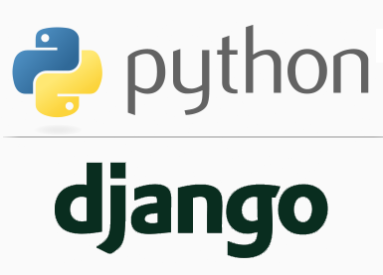
FULL STACK WEB DEVELOPMENT WITH DJANGO
Lecture 5

Slide 2

Today’s Agenda
Developing Django Project Using VS Code
Creating Django Environment In VS
Creating Django Project In VS
Running The Django Project In VS

Slide 3
Creating And Running Django Project From VS Code
Since we will be using the VS Code IDE for our project designing , so we must learn how to set up and use Django in Visual Studio Code.
We will create a Django Project in the context of Visual Studio Code in order to understand how to work with Django in the VS Code terminal and editor.
Before moving further , we must install Python extension for VS Code from the following link:
https://marketplace.visualstudio.com/items?itemName=ms-python.python

Slide 4
Creating Django Environment In VS Code
The first step as before is to create a virtual environment and install Django in it.
To do this , follow the steps given below:
Create a project folder anywhere on your computer.
We are creating it in D:\djangoexamples by the name myvsdjangoproject.
So the complete path is D:\djangoexamples\myvsdjangoproject

Slide 5
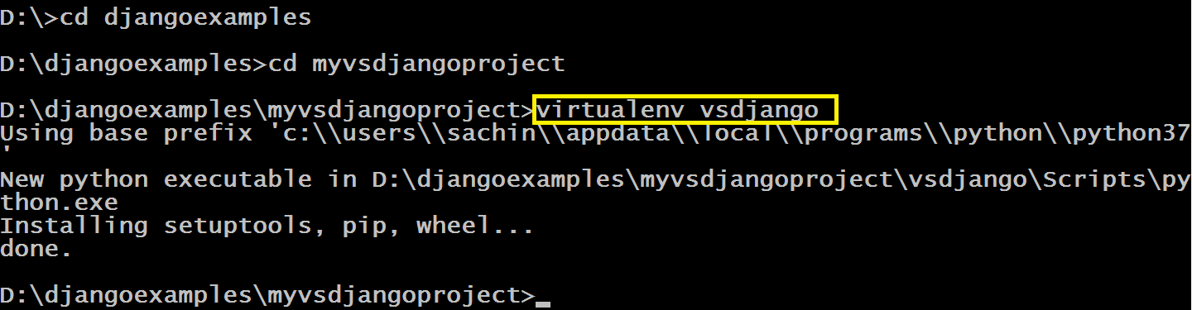
Creating Django Environment In VS Code
Now go to the project directory myvsdjangoproject and create a virtual environment there by the name vsdjango using the command as shown below
Type the command : virtualenv vsdjango

Slide 6
Creating Django Environment In VS Code
Launch VS Code and open the project folder myvsdjangoproject
In VS Code, open the Command Palette (View > Command Palette or (Ctrl+Shift+P)).
Then select the Python: Select Interpreter command:

Slide 7
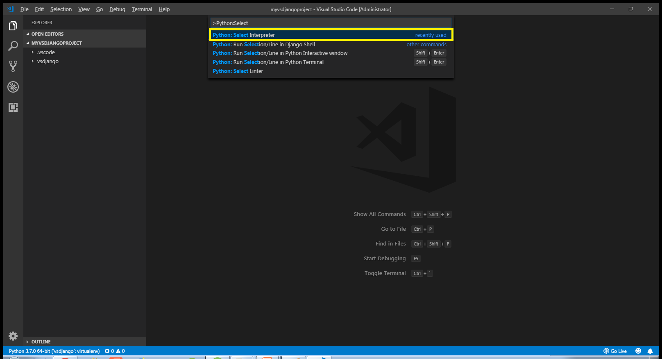
Creating Django Environment In VS Code

Slide 8
Creating Django Environment In VS Code
The command presents a list of available interpreters that VS Code can locate automatically.
Select the virtual environment in our project folder.
In our case it will be vsdjango
The selected environment appears on the left side of the VS Code status bar, and notice the "(virtualenv)" indicator that tells you that you're using a virtual environment:

Slide 9
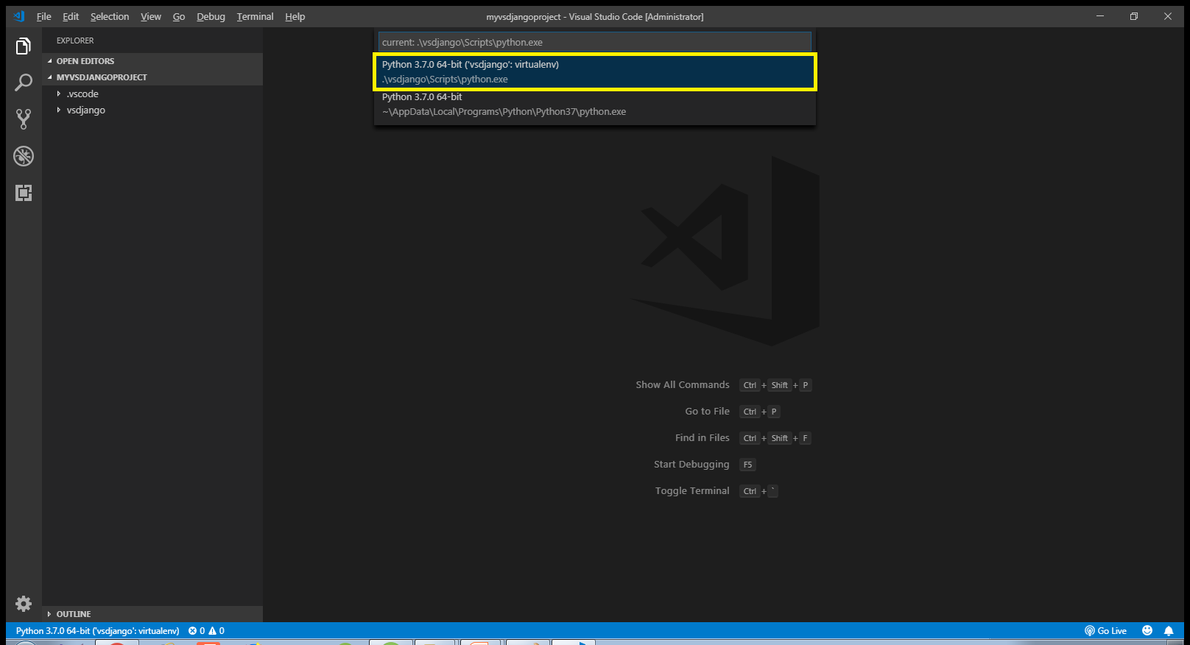
Creating Django Environment In VS Code

Slide 10
Creating Django Environment In VS Code
Now select Run Terminal: New Terminal (Ctrl+Shift+`) from the menu bar, which creates a terminal and automatically activates the virtual environment by running its activation script.

Slide 11
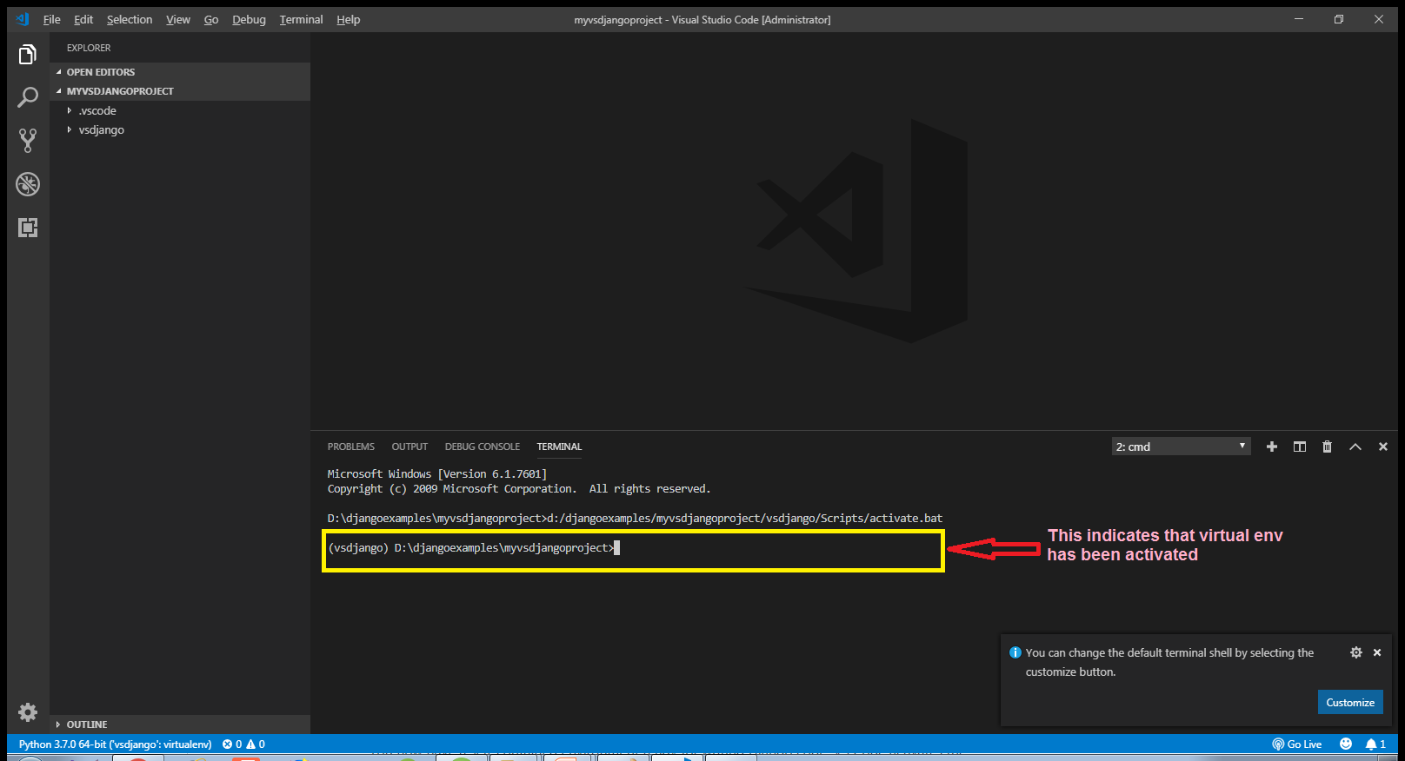
Creating Django Environment In VS Code

Slide 12
Creating Django Environment In VS Code
Install Django in the virtual environment by running the following command in the VS Code Terminal:
pip install django

Slide 13
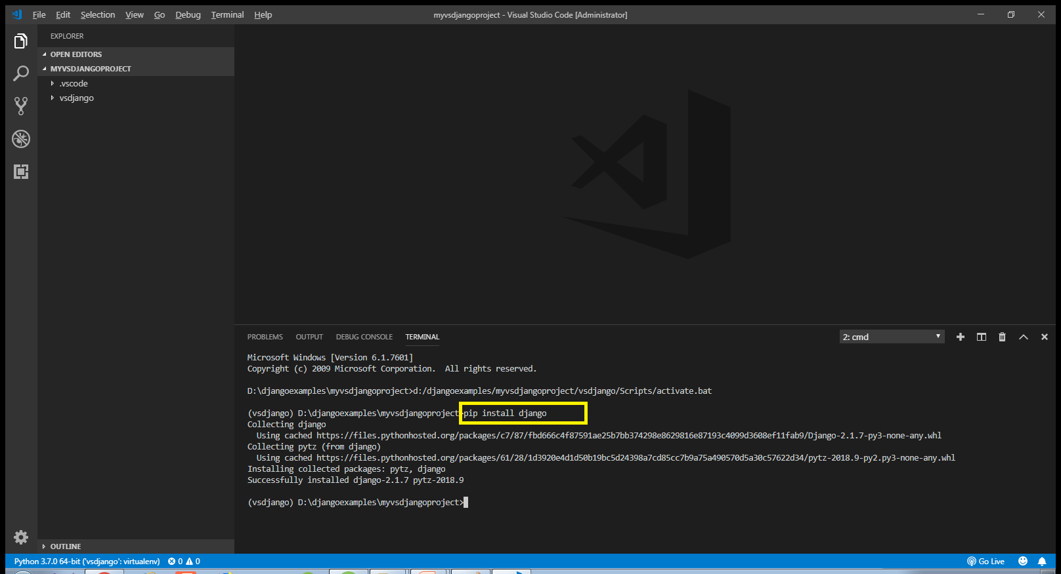
Creating Django Environment In VS Code

Slide 14
Creating Django Environment In VS Code
We now have a self-contained environment ready for writing Django code.
VS Code automatically activates the environment when you use Terminal: New Terminal.

Slide 15
Creating Django Project In VS Code
Now the next task is to create the Django project, which is done by typing the following command at VS Code terminal:
django-admin startproject demoproject
Doing this will generate the same file/folder structure as we saw before

Slide 16
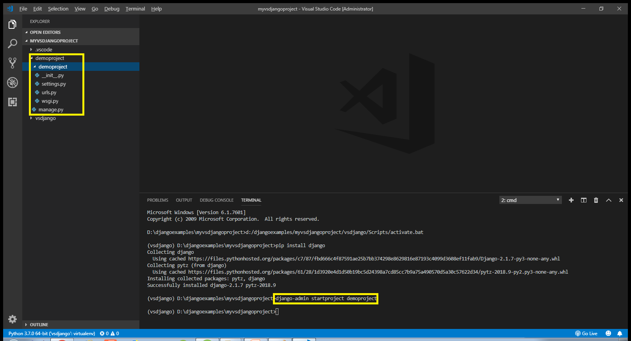
Creating Django Project In VS Code

Slide 17
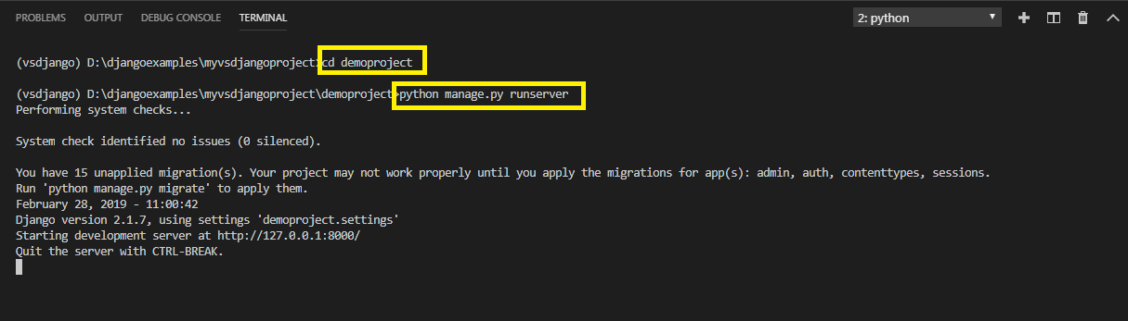
Creating Django Project In VS Code
To verify the Django project, go to the folder demoproject by using cd command and type the runserver command in VS Code terminal
cd demoproject
python manage.py runserver.
The server runs on the default port 8000, and we’llsee output like the following output in the terminal window:

Slide 18
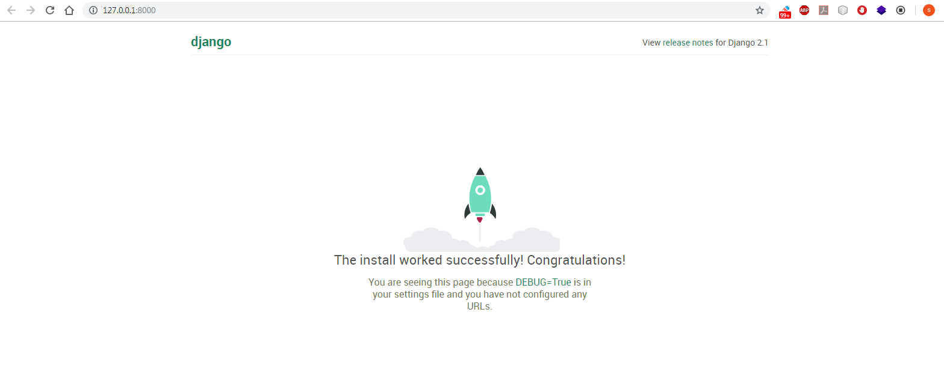
Creating Django Project In VS Code
Ctrl+click the http://127.0.0.1:8000/ URL in the terminal output window to open the default browser to that address. If Django is installed correctly and the project is valid, we’ll see the default page shown below. The VS Code terminal output window also shows the server log.

Slide 19
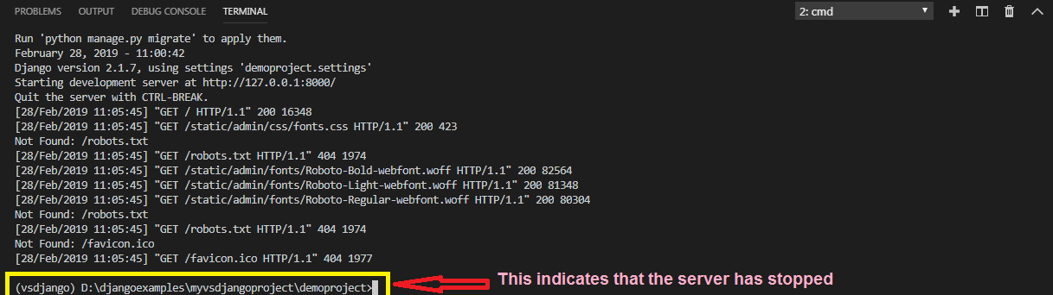
Creating Django Project
When we're done, close the browser window and stop the server in VS Code using Ctrl+C as indicated in the terminal output window.

